Slide 1
Confidence Intervals Proportions
Chapter 18

Slide 2
Central Limit Theorem
For larger and larger sample size n, we expect the Sampling Distribution’s
shape to become more Normal (unimodal and symmetric)
center to stay the same
spread to become smaller
For Quantitative Data:
SD = $\frac{σ}{\sqrt{n}}$ where $σ=\text{standard} \text{deviation} \text{of} \text{the} \text{population}$
For Categorical Data:
SD =$\sqrt{\frac{p(1−p)}{n}}$ where p = proportion in the population

Slide 3
What if “p” is unknown?
p = Population Proportion (parameter)
$\hat{p}$ = Sample Proportion (statistic)
We can use $\hat{p}$ to calculate a confidence interval to predict p!

Slide 4
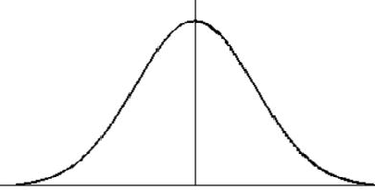
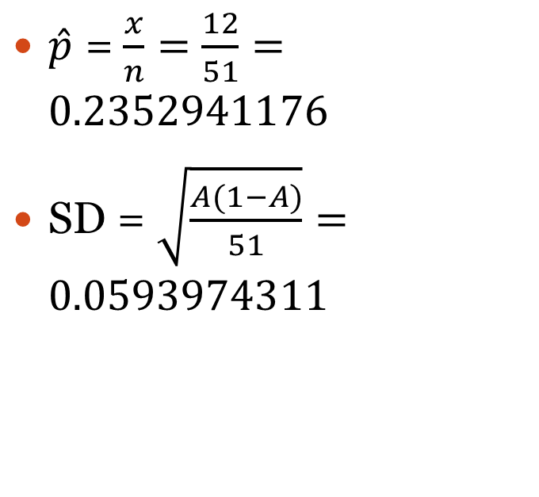
Predict the proportion of p = BLUE MM’s that the Mars Co uses to fill each bag
Draw Normal Curve:
Example:
Calculate $\hat{p}$ = $\frac{x}{n}=\frac{\text{\# }\text{sample} \text{of} \text{blue} \text{MM}\text{′}\text{s}}{\text{total} \text{sample} \text{size}}$
Calculate SD = $\sqrt{\frac{\hat{p}(1−\hat{p})}{n}}$
Here the SD is called a standard error = SE
$\hat{p}$ = $\frac{x}{n}=$ $\frac{12}{51}=0.2352941176$
SD = $\sqrt{\frac{A(1−A)}{51}}=0.0593974311$
STO “A”
STO “B”
Blue MM’s
n=51
0.06
0.12
0.24
0.30
0.36
0.18
0.42

Slide 5
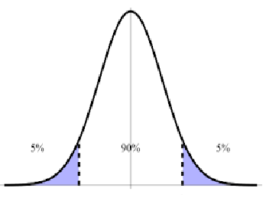
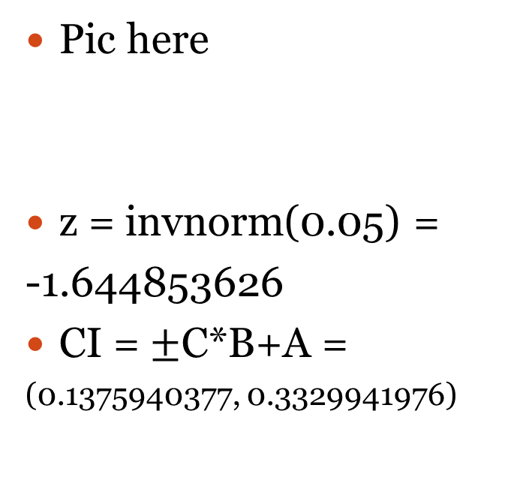
Example continued…
Calculate 90% Confidence Interval:
Example:
Recall 90% center area means 5% left area
Find z = invnorm(0.05) = -1.644853626
Find data = $CI=±$z*SD+center
Pic here
z = invnorm(0.05) =
-1.644853626
CI = $±$C*B+A =
(0.1375940377, 0.3329941976)
STO “C”

Slide 6
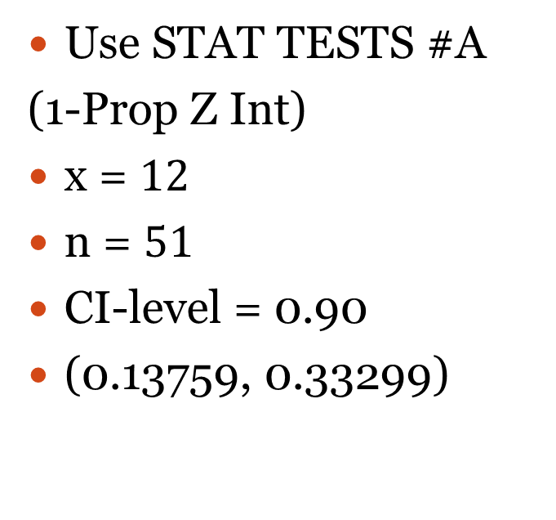
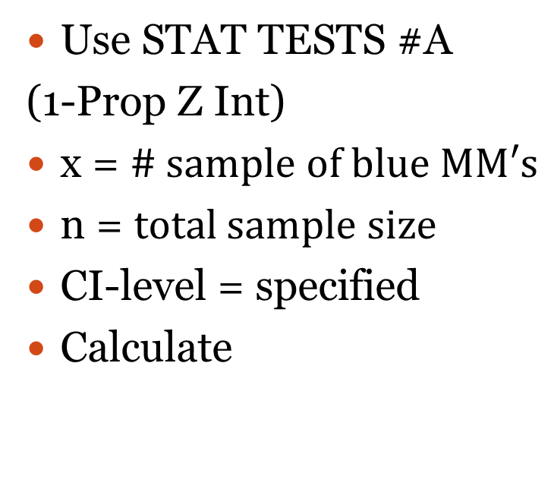
Example continued…
Check:
Example:
Use STAT TESTS #A
(1-Prop Z Int)
x = $\text{\# }\text{sample} \text{of} \text{blue} \text{MM}\text{′}\text{s}$
n = $\text{total} \text{sample} \text{size}$
CI-level = specified
Calculate
Use STAT TESTS #A
(1-Prop Z Int)
x = $12$
n = $51$
CI-level = 0.90
(0.13759, 0.33299)
Use this only to check. You will be asked to do full calculation on exam!

Slide 7
Conclusions
We say…
We don’t say…
We are __% confident that the true proportion of __ is between __ and __.
We expect __% of all possible confidence intervals calculated with sample size n to contain the true proportion of the population.
There is a __% chance of a particular value in the interval.
There is a __% chance the proportion of the population is in the interval.

Slide 8
How was our prediction?
Mars Co claims that it fills each bag with 24% blue MM’s.
Raise your hand if 24% is in your interval. We would expect about 90% of the class to have a hand raised!

Slide 9
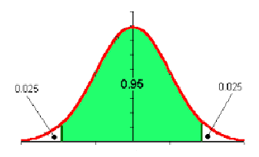
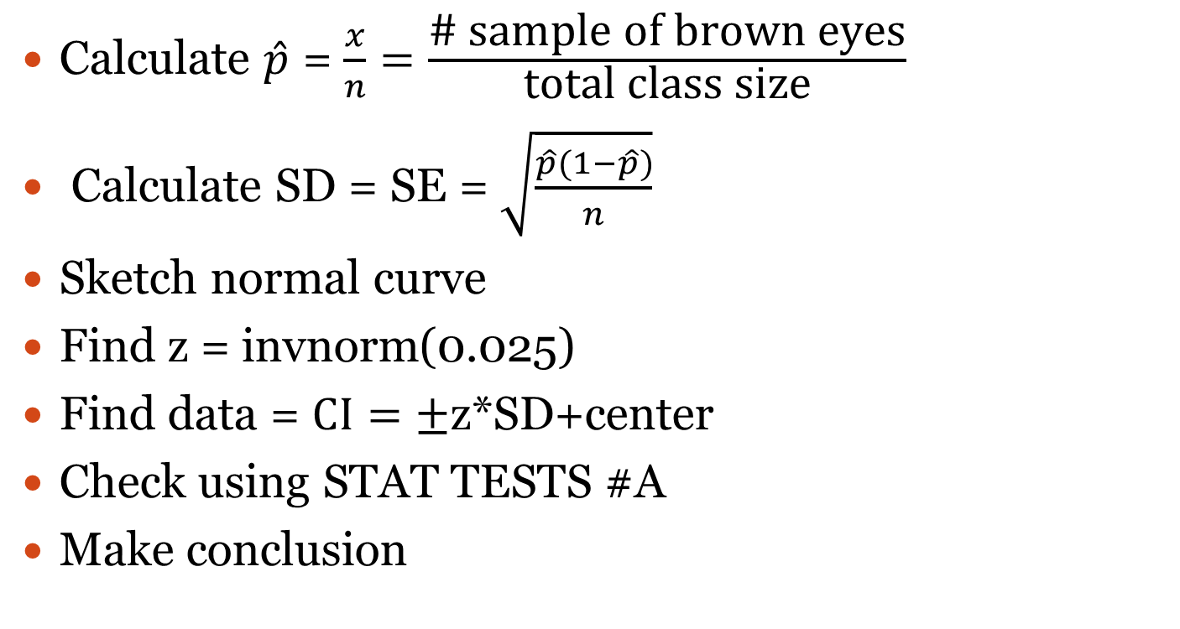
Predict proportion of brown eyes using class as sample using 95% confidence
Calculate $\hat{p}$ = $\frac{x}{n}=\frac{\text{\# }\text{sample} \text{of} \text{brown} \text{eyes}}{\text{total} \text{class} \text{size}}$
Calculate SD = SE = $\sqrt{\frac{\hat{p}(1−\hat{p})}{n}}$
Sketch normal curve
Find z = invnorm(0.025)
Find data = $CI=±$z*SD+center
Check using STAT TESTS #A
Make conclusion

